Slide 1
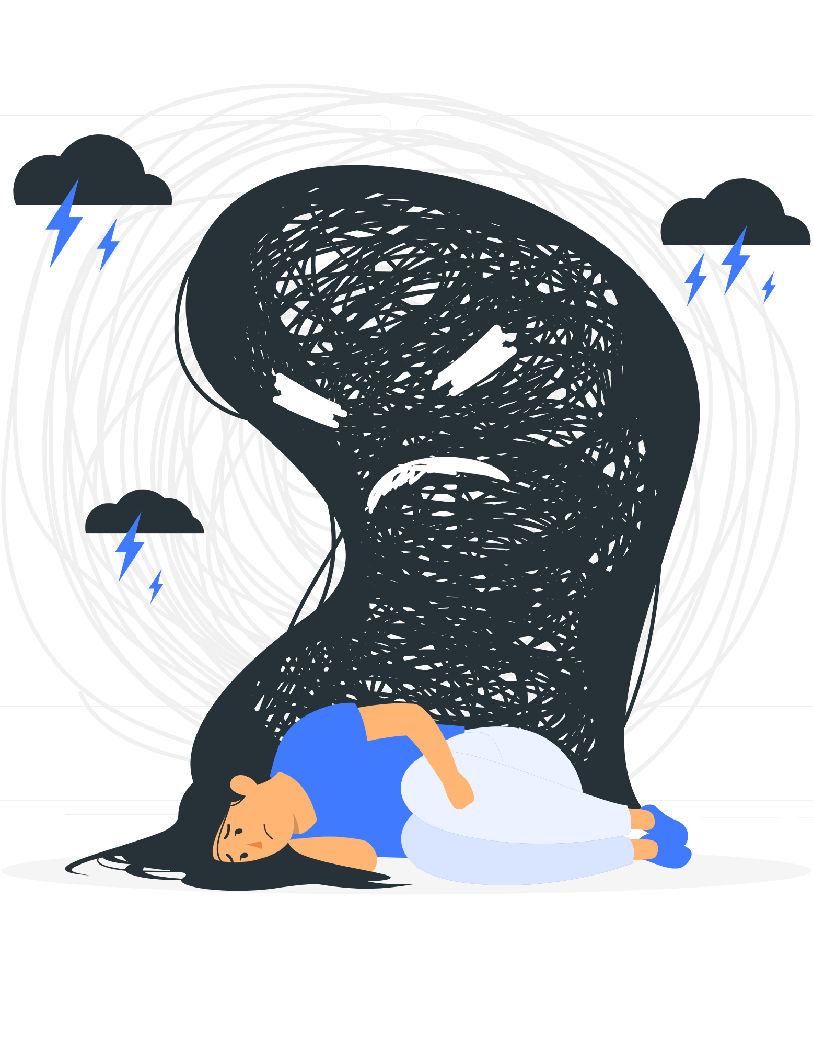
HEALMINDS
Objective : Our objective is to provide accessible and reliable resources for promoting mental well-being, offering support, and fostering a community of understanding.

Slide 2

Introduction
In the always-changing world of learning, how students feel has become a very important concern. As schools and colleges try to create a good place for students to learn and grow, the mix of school pressures, what people expect, and each student's own problems has become a big challenge. Recognizing how urgent it is to deal with this complex problem, the new idea "HealMinds" steps up as a helpful force, dedicated to making students feel better and stronger in schools and colleges.
The journey through school, which used to be mostly about learning and growing, is now connected to how students feel inside. The needs of today's education, along with the pressures from society and each student's own struggles, have created a unique set of challenges that go beyond just doing well in classes.
"HealMinds" stands out as a helpful friend, ready to fill the gaps in taking care of students' feelings within schools. It is not just about the usual ways of helping with feelings; it is a complete and new solution made for the different and changing needs of students. At its heart, HealMinds wants to do more than just give things to use; it aims to create a friendly group, pushing for students to take an active and complete approach to how they feel.

Slide 3
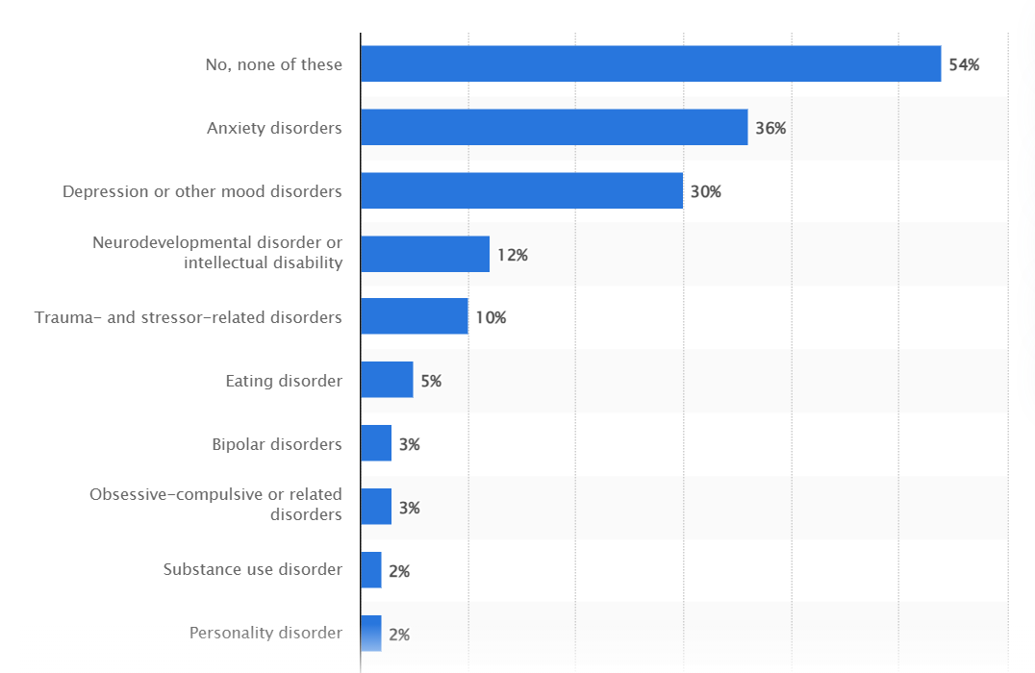
The many kinds of challenges students face are a big focus for HealMinds. The platform knows that what students go through is complicated, including dealing with class stress and figuring out how to manage problems in friendships or personal troubles. By understanding this complexity, HealMinds puts itself forward as a flexible and ready solution, adapting to the changing ways students need help with their feelings.
Key to the approach of HealMinds is giving a lot of different things to help with many parts of feeling good. From calming activities like meditation and yoga to interesting podcasts, tools to check how you are feeling, connections to someone to talk to, checkups for your physical health, interesting blogs, and playlists of good music, HealMinds offers a complete set of things that work together to help students feel good in different ways. This wide range of things shows the commitment to a full and fair way of promoting feeling good inside.
One special part of the HealMinds platform is the "General Test." This creative tool works as a first way to check how a student feels inside. By using a careful way to score, the test puts users into different levels of how they feel, offering a personal way to help them. If a student scores below a set level, showing that they might be feeling bad, HealMinds takes quick action by sending them to talk to someone who can help them right away. On the other side, students who score higher get ideas and suggestions made just for them, giving them the power to take control of how they feel inside.

Slide 4
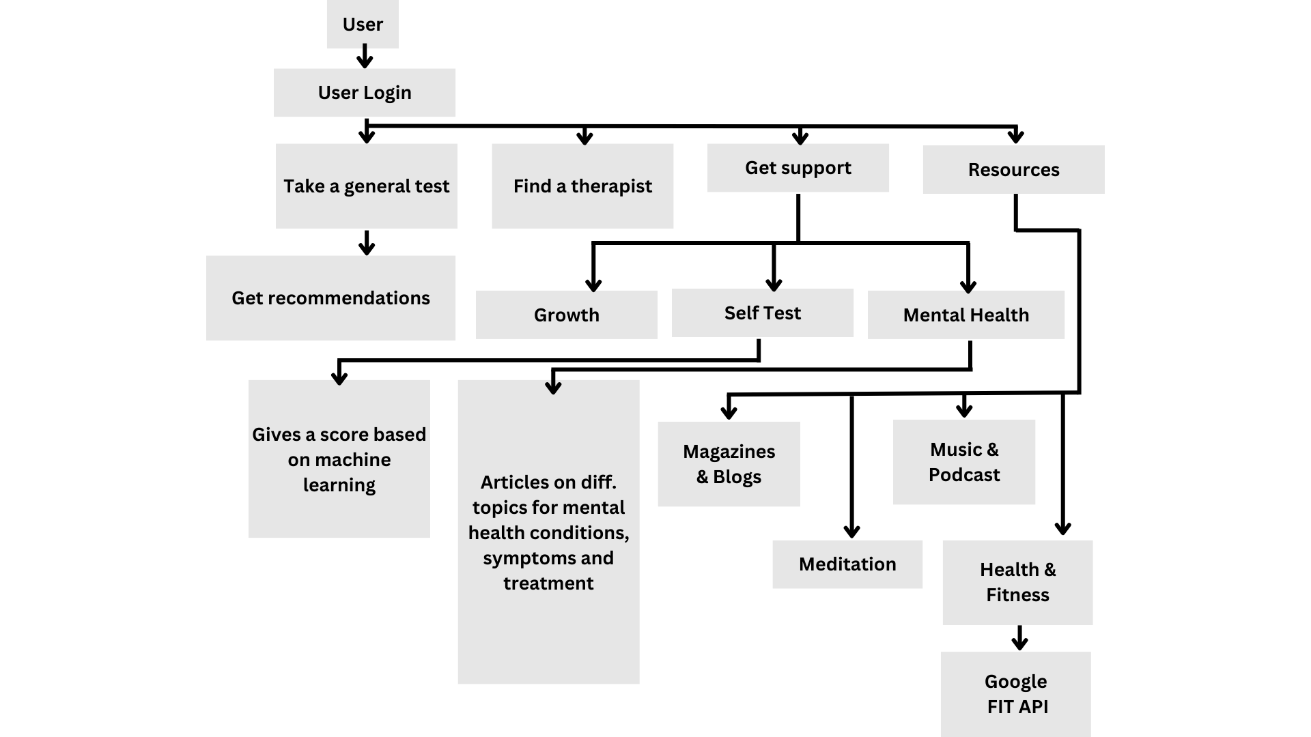
Methodology
User Flow :
HealMinds uses an assessment test and machine learning to provide customized mental health recommendations and access to relevant resources like articles, blogs, and podcasts on mental health topics. It also connects with fitness tracking to promote healthy habits. This personalized platform supports mental health through tailored suggestions and diverse learning materials enabled by technology.

Slide 5
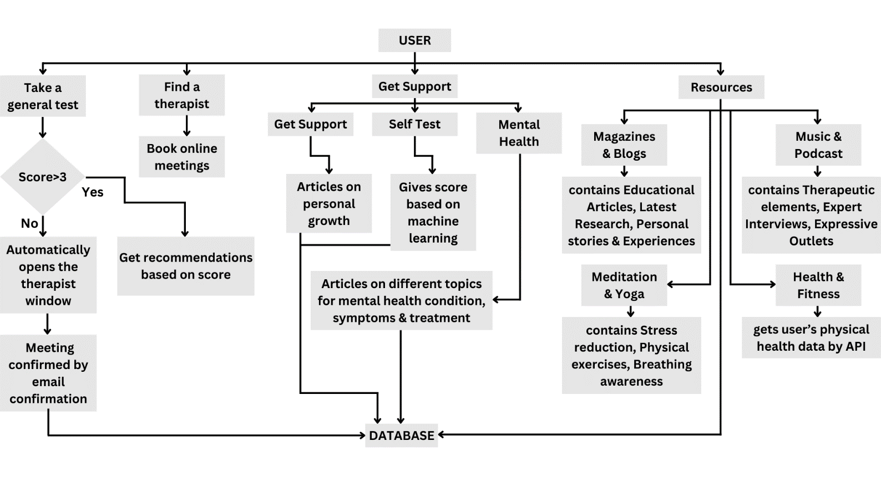
Methodology
Data Flow Diagram:
The following diagram shows the flowchart for the mental health platform HealMinds. HealMinds uses a self-assessment to provide users their score and articles tailored to their needs. It offers different resources and connects to fitness tracking for a comprehensive approach.

Slide 6
Technology Stack
HTML: Explain that HTML (Hypertext Markup Language) is used for structuring the content of web pages. Highlight its role in creating the layout and elements of the project's user interface.
CSS: Describe CSS (Cascading Style Sheets) as the language used for styling the appearance of web pages. Discuss how CSS is utilized to enhance the visual design and aesthetics of the project.
JavaScript: Define JavaScript as the programming language used for adding interactivity and functionality to web pages. Explain how JavaScript is employed to implement dynamic features and user interactions in the Mental Health Tracker Mini Project.

Slide 7





Features
Resource Directories
To provide users with a comprehensive list of resources including mental health professionals, support groups, educational material, and local services.
To sum it up, this introduction gives a big look into what HealMinds wants to do, what it offers, and the way it plans to make a big change. As we go deeper into the many parts of this idea, we will see how HealMinds is a leader in creating a healthier and stronger group of students, making a big impact on how students learn and grow in schools.
Self-Help Tools
To offer tools that assist individuals in managing their mental health on a daily basis.
Online Counselling Services
To provide access to professional counseling or therapy sessions via the internet, allowing for convenience and privacy.
Integration with APIs
To enhance the website’s functionality and user experience by integrating with other services.
Automatically booking of meeting & appointments
To simplify the process of scheduling appointments with mental health professionals or support groups.

Slide 8
Implementation
Jan 20XX
Coordinate e-business applications
May 20XX
Deploy strategy networks with compelling e-business needs
HEALMINDS is a student-focused mental health project designed to provide comprehensive support and resources for the well-being of students. The implementation of this project involves the creation of an accessible online platform with a user-friendly interface, ensuring that students can easily navigate through the diverse range of resources. The platform offers a holistic approach to mental health, covering various aspects such as magazines, blogs, music, podcasts, meditation, yoga, and health & fitness.
One of the key features is the provision of detailed articles addressing different mental health conditions, their symptoms, and available treatments. This information aims to enhance users' understanding of mental health, fostering a supportive and informative environment. HEALMINDS further incorporates self-assessment tools, allowing users to gauge their mental health through interactive quizzes. In the case of a low score on the general test, the platform guides users to seek professional help by facilitating the process of booking a therapist.
HEALMINDS strives to create an interactive community by encouraging user engagement through discussion forums and collaborative spaces. Regularly updated content ensures that the platform remains current with the latest research, trends, and insights in the field of mental health. Additionally, the project promotes inclusivity by addressing a wide range of mental health concerns and experiences, making it a welcoming space for all users.
In conclusion, the implementation of HEALMINDS aims to create a supportive and inclusive online environment where students can access valuable resources, assess their mental health, and seek assistance when needed. Through a thoughtful and user-centric approach, HEALMINDS endeavors to make a positive impact on the mental well-being of students.
Nov 20XX
Disseminate standardized metrics
Mar 20XX
Foster holistically superior methodologies

Slide 9
Results
Develop winning strategies to keep ahead of the competition
The results of the HEALMINDS project showcase a positive impact on the mental well-being of students within the online community. Through the user-friendly platform, students have gained easy access to a diverse range of mental health resources. The implementation of detailed articles addressing various mental health conditions, symptoms, and treatments has empowered users with a better understanding of their mental health.
Cloud-based opportunities
Iterative approaches to corporate strategy
Establish a management framework from the inside
The inclusion of self-assessment tools, such as interactive quizzes, has allowed students to evaluate their mental health status in a supportive and informative environment. In cases where users scored low on the general test, the streamlined process for booking a therapist has facilitated timely professional intervention, promoting a proactive approach to mental health care.

Slide 10

Conclusion
In conclusion, HealMinds is like a caring companion for students, providing tools to support their mental well-being. It offers helpful resources such as meditation guides, yoga sessions, and connections with therapists, creating a space where students can find what they need to feel better.
The project is committed to continually improving and growing. We are dedicated to adding more features and staying up-to-date with the latest ways to support students. HealMinds is all about ensuring that students feel empowered and connected as they navigate their academic journey.
As HealMinds evolves, our focus remains on being a reliable source of support for students, promoting positive mental health practices and fostering a sense of community and more resilient student population.

Slide 11
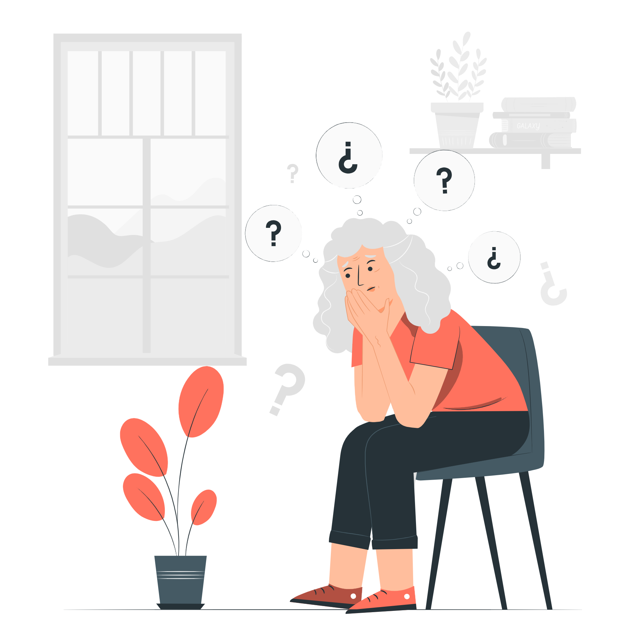
References
Rudy, M. (2023). Jewish students struggling with antisemitism at college now have use of walk-in mental health clinic.
Abrams, Z. (2022). Student mental health is in crisis.
Weissbourd, R., & Batanova, M. (2023). Mental Health Challenges of Young Adults Illuminated in New Report. Harvard Graduate School of Education.
New CDC data illuminate youth mental health threats during the COVID-19 pandemic. CDC Online Newsroom 2022.
https://psychologytoday.com
https://scholar.google.com
https://www.statista.com/

